Slide 1
The std::string class

Slide 2
Outline
In this lesson, we will:
Describe issues with the primitive data types
Introduce the 3-body problem and an attempt to solve it
Introduce the struct keyword and member variables
Create a 3-dimensional vector data structure
Describe assigning to and using the member variables
Describe passing instances of data structures as arguments
We will create a library of functions for vectors
Initialize instances of data structures
Revisit our 3-body problem
Determine if we have a solution to arrays

Slide 3
Limitations of character arrays
Up to now, strings are a null-terminated array of char:
The string is stored in a character array
The string itself includes all characters before the first '\0'
These are referred to as null-terminated strings

Slide 4
Limitations of character arrays
This code hopes that your name never has more than 99 characters:
int main() {
char text[100];
std::cout << "Enter your name: ";
std::cin >> text;
std::cout << “Hi, " << text << "!" << std::endl;
std::size_t length{0};
for ( ; text[legnth] != '\0'; ++length ) {
// Do nothing
}
std::cout << "Your name has " << length << " characters"
<< std::endl;
return 0;
}
Output:
Enter your name: Elizabeth
Hi, Elizabeth!
Your name has 9 characters.

Slide 5
Limitations of character arrays
The maximum number of characters in the array need not equal the capacity of the array:
char text[100]{"Hello world!"};
Here:
The capacity of the array is 100 characters
The actual length of the string is 12
The maximum length of a string in this array is 99

Slide 6
Limitations of character arrays
This function compares two strings for equality:
int strcmp( char *str1, char *str2 ) {
for ( std::size_t k{0}; true; ++k ) {
int diff{ str1[k] - str2[k] };
if ( (diff != 0) || (str1[k] == '\0')
|| (str2[k] == '\0') ) {
return diff;
}
}
}
If both strings were in a dictionary, this returns:
a negative number if str1 comes before str2,
0 if they are equal, and
a positive number if str1 comes after str2.

Slide 7
Limitations of character arrays
There is an entire library for interacting with character arrays:
#include <cstring>
This C library dates back to the 1970s:
“C-style” strings
strlen | Find the position of the null character '\0'
strcmp | Compare two character arrays
strncmp | Compare first n characters
strcpy | Copy one character array to another
strncpy | Copy up to n characters from one character array to another
strcat | Concatenate one character array to the end of another
strncat | Concatenate up to n characters from one character array to another
strchr | Locate the first instance of a character in a character array
strstr | Locate the first instance of one character array within another

Slide 8
A string class
It sounds as if a lot of this should be stored in a std::string class:
#include <string>
This library defines both
The string class
Member functions to access and manipulate them
Other functions that interact with strings
C++ string class

Slide 9
A string class
Here is an example:
int main() {
std::string str{"Hello world!"};
std::cout << str.length() << std::endl;
std::cout << "Capacity: " << str.capacity() << std::endl;
str.resize( 5 );
for ( std::size_t k{0}; k < str.length(); ++k ) {
std::cout << str.at( k );
}
std::cout << std::endl;
str.push_back( '!' );
str.append( " Are you there?" );
std::cout << "Capacity: " << str.capacity() << std::endl;
std::cout << str << std::endl;
return 0;
}
Output:
12
Capacity: 15
Hello
Capacity: 30
Hello! Are you there?

Slide 10
A string class
There are many other operations:
std::string name{};
std::string surname{};
std::cout << "Enter your first name: ";
std::cin >> name;
std::cout << "Enter your last name: ";
std::cin >> surname;
name += " " + surname;
if ( name == "Winston Smith" ) {
std::cout << "Big Brother is Watching You." << std::endl;
}

Slide 11
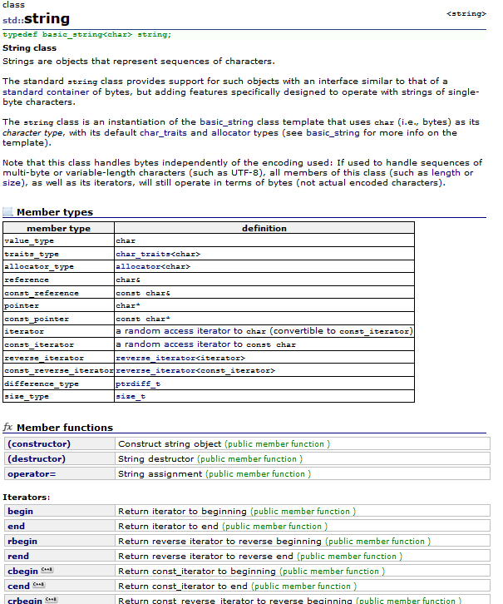
3-dimensional vectors
These are all documented online:
http://www.cplusplus.com/reference/string/string/

Slide 12
3-dimensional vectors
One common operation on many classes is to convert an instance of the class to a string:
class Vector_3d{
public:
// Member variables...
// Member functions
std::string to_string() const;
// other member functions...
};
How a class is converted to a string is a personal preference:

Slide 13
3-dimensional vectors
How a class is converted to a string is a personal preference:
For example
std::string Vector_3d::to_string() const {
return "(" + x + ", " + y + ", " + z + ")";
}
Attempting to compile this causes a problem:
sample.cpp: In member function
‘std::__cxx11::string Vector_3d::to_string() const’:
sample.cpp:43:17: error: invalid operands of types ‘const char [2]’ and
‘const double’ to binary ‘operator+’
return "(" + x + ", " + y + ", " + z + ")";
~~~~^~~
The compiler is saying:
“I don’t know how to add a character array and a double.”

Slide 14
3-dimensional vectors
Reading through the documentation, you find a std::to_string(…) command in the string library:
std::string Vector_3d::to_string() const {
return "(" + std::to_string( x ) + ", "
+ std::to_string( y ) + ", "
+ std::to_string( z ) + ")";
}
Now we can use this:
int main() {
Vector_3d v{1, 2, 3};
std::cout << v.to_string() << std::endl;
return 0
}
Output:
(1.000000, 2.000000, 3.000000)

Slide 15
3-dimensional vectors
Reading online at cplusplus.com, we see
function
std::to_string <string>
string to_string (int val);
string to_string (long val);
string to_string (long long val);
string to_string (unsigned val);
string to_string (unsigned long val);
string to_string (unsigned long long val);
string to_string (float val);
string to_string (double val);
string to_string (long double val);
Convert numerical value to string
Returns a string with the representation of val.

Slide 16
3-dimensional vectors
Notice the difference in output:
int main() {
Vector_3d v{1, 2, 3};
std::cout << v.to_string() << std::endl;
std::cout << "(" << v.x << ", "
<< v.y << ", "
<< v.z << ")" << std::endl;
return 0
}
You can refine how a primitive data type is converted to a string with the std::sprint(…) function
Output:
(1.000000, 2.000000, 3.000000)
(1, 2, 3)

Slide 17
Summary
Following this lesson, you now
Understand the struct keyword
Know how to declare, access and manipulate the member variables
Know how to pass instances of data structures to functions
Understand how to initialize instances
Understand how data structures can contain data structures
Know that this simple solution cannot solve our issues with arrays

Slide 18
References
[1] No references?

Slide 19



Colophon
These slides were prepared using the Georgia typeface. Mathematical equations use Times New Roman, and source code is presented using Consolas.
The photographs of lilacs in bloom appearing on the title slide and accenting the top of each other slide were taken at the Royal Botanical Gardens on May 27, 2018 by Douglas Wilhelm Harder. Please see
https://www.rbg.ca/
for more information.

Slide 20
Disclaimer
These slides are provided for the ece 150 Fundamentals of Programming course taught at the University of Waterloo. The material in it reflects the authors’ best judgment in light of the information available to them at the time of preparation. Any reliance on these course slides by any party for any other purpose are the responsibility of such parties. The authors accept no responsibility for damages, if any, suffered by any party as a result of decisions made or actions based on these course slides for any other purpose than that for which it was intended.

